Slide 1


Introduction
AI Core’s Data Science and Machine Learning Summer School

Slide 2

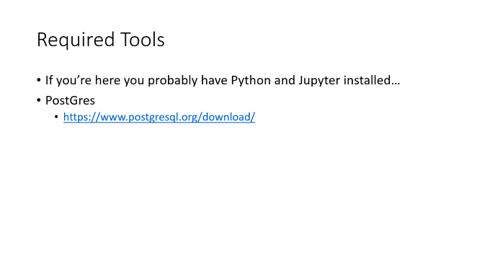

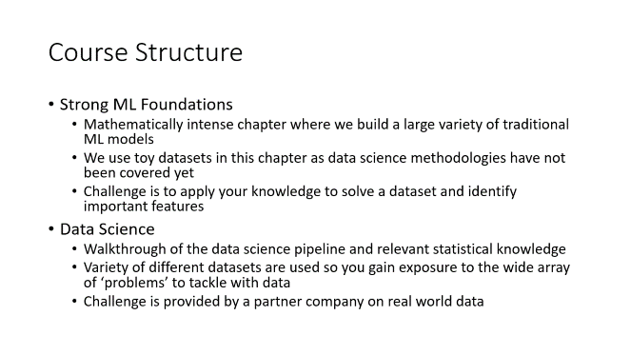
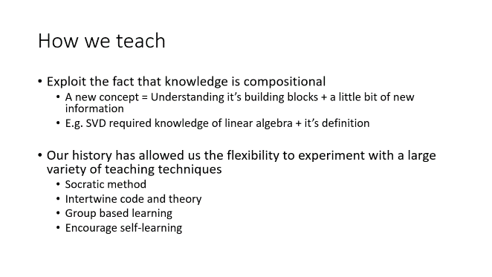
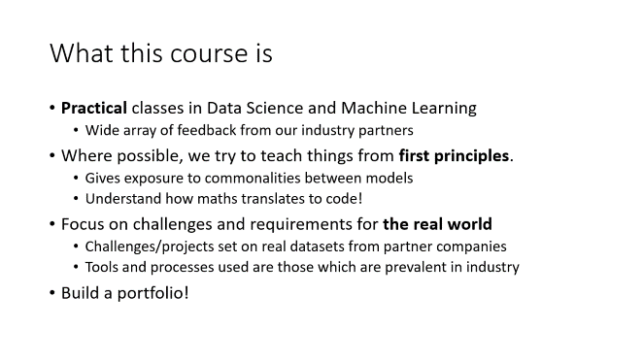
Contents

Slide 3

Welcome!

Slide 4


Teaching Team
Harry Berg
Nihir Vedd

Slide 5
What this course is
Practical classes in Data Science and Machine Learning
Wide array of feedback from our industry partners
Where possible, we try to teach things from first principles.
Gives exposure to commonalities between models
Understand how maths translates to code!
Focus on challenges and requirements for the real world
Challenges/projects set on real datasets from partner companies
Tools and processes used are those which are prevalent in industry
Build a portfolio!

Slide 6
How we teach
Exploit the fact that knowledge is compositional
A new concept = Understanding it’s building blocks + a little bit of new information
E.g. SVD required knowledge of linear algebra + it’s definition
Our history has allowed us the flexibility to experiment with a large variety of teaching techniques
Socratic method
Intertwine code and theory
Group based learning
Encourage self-learning

Slide 7
Course Structure
Strong ML Foundations
Mathematically intense chapter where we build a large variety of traditional ML models
We use toy datasets in this chapter as data science methodologies have not been covered yet
Challenge is to apply your knowledge to solve a dataset and identify important features
Data Science
Walkthrough of the data science pipeline and relevant statistical knowledge
Variety of different datasets are used so you gain exposure to the wide array of ‘problems’ to tackle with data
Challenge is provided by a partner company on real world data

Slide 8
Course Structure
The Real World
Collaboration and reporting tools used in industry
‘Tricks’ to increase development speed
Optimization techniques required for deployable production code
Soft skills!
Challenge is a group project set provided by partner company
Deep Learning
Neural networks, Convolution Neural Networks (for images) and RNNs (for time series data)
Tips and tricks regarding neural models

Slide 9
Course Structure
Natural Language Processing
Another intense chapter! But by now you’ll have the knowledge and mindset to understand the workflow
Taught under the context of translation, we’ll build some SoTA models
Self project
Everyone on this course probably has their own interests with the different aspects of Data Science and Machine Learning
We want to encourage and facilitate this by allowing you to choose from a set of projects which interest you

Slide 10
Required Tools
If you’re here you probably have Python and Jupyter installed…
PostGres
https://www.postgresql.org/download/

